Slide 1
Interaction Events & Tie Dynamics

Slide 2
Life of a Tie
Ties (edges) have a life
  Beginning date
  Ending date
Tie dynamics (changes): 3 Processes
  Tie Formation
  Tie evolution (maintenance)
  Tie decay
Tie Formation
  Social Foci
  Preference (Choice) Homophily
  Triadic closure
  Preferential Attachment
Tie evolution
Tie Decy

Slide 3

Graphs & Events
G = {V, E} set of vertices and set of edges (arcs) connecting vertices
How do we determine if an edge exists between two vertices?
  X_{ij} = 1 tie variable
Measurement
  Specify the relationship
  Devise protocol to indicate presence/absence of an edge

Slide 4
Interaction Events and Social Networks
What is a social network?
  Sets of vertices and edges: G(N,M)
  When does an edge between two vertices exist?
  Social interaction event: e_{ij}(t_{k}) = 1
    communicative interaction
Social Network Dynamics
  Temporal pattern of the interactions
  Beginning and end to a sequence of interactions

Slide 5
Social Interaction
Communication interaction
  But also exchanges, transfers, purchases, joint activities
Can and often is directional in terms of sender/receiver
Communication (interaction) events
  a_{ijt} = 1 communication from i to j starting at time t
Communication edges
  x_{ij(t,t+Δt)} = 1 if a_{ijt*} = 1 where t ≤ t* ≤ t + Δt
  Could filter by tie frequency
Tie (Event) Frequency (aka tie strength)
  w_{ij(t,t+Δt)} = ∑a_{ijt} = 1 within time period t, t + Δt
Aggregating events across time to compute indicator of an edge
Some lost of information
  Sequencing of events
  Waiting times between events

Slide 6
Dating Ties
Beginning date: first interaction
  Problem of left-censoring.
  NetHealth assume first interaction at ND is first interaction.
Ending date: Date of last interaction
  Problem of dormant tie
  How much time after an interaction has occurred before probability of another interaction is very small?
    NetHealth numbers: two semesters

Slide 7
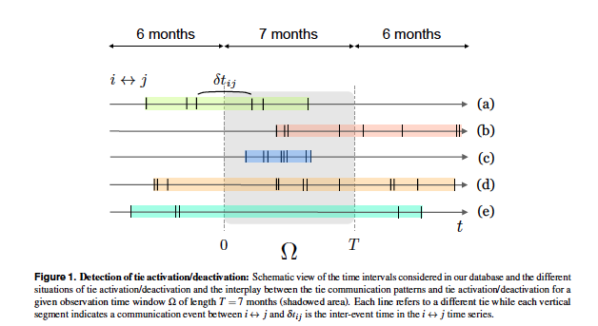

Slide 8
Effective edge
x*_{ijt} = 1 if a_{ijt*} = 1 for t* <= t and a_{ijt*} = 1 for t* >= t
An edge between i and j is effective at a give point in time t iff there had been interaction between i and j prior to (or at) t and there is interaction between i and j after t.
Active and effective edge
  a_{ijt} = 1 , active at time t because of an event
  X*_{ijt} = 1 , effective at time t event if a_{ijt} = 0

Slide 9
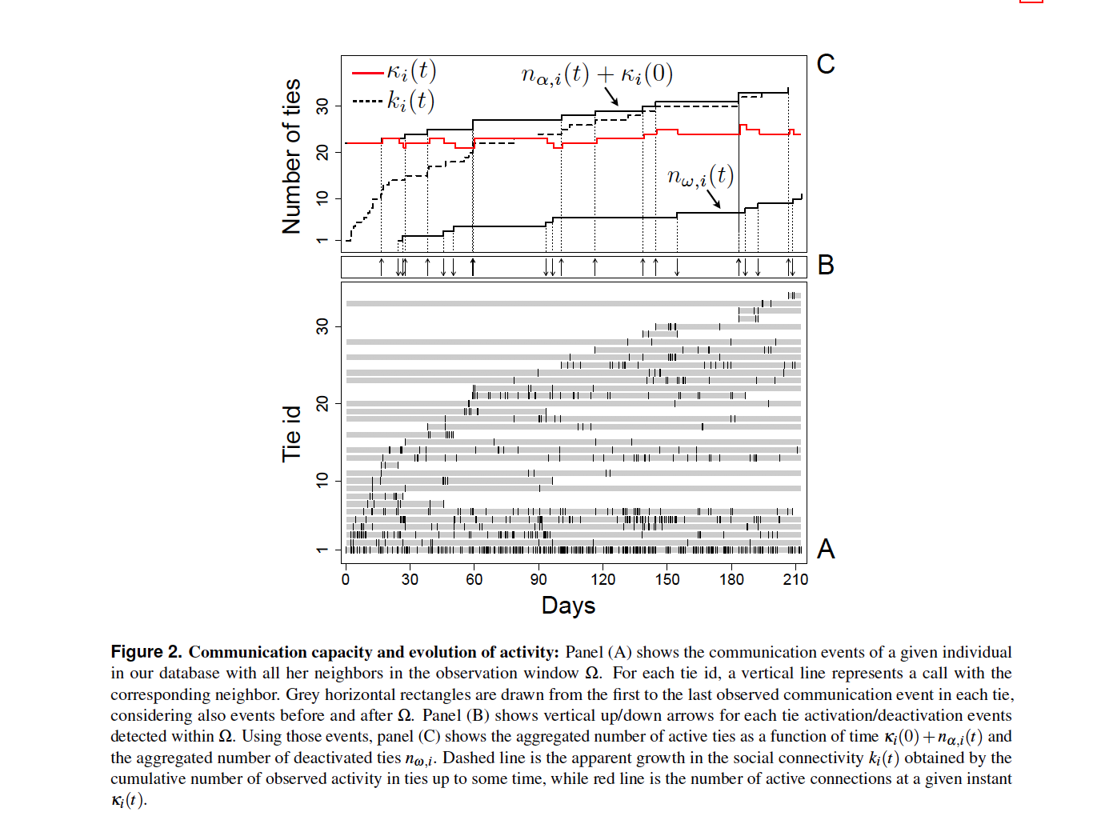
Effective Degree
d_{i}= ∑x_{ij} = 1 over all j’s
d_{i(t,t+Δt)} = ∑x_{ij(t,t+Δt)}
d_{i(t,t+Δt)} = d_{it} for t at the end of the period
Cumulative degree: number of new ties
  Plus number of ties at beginning of the period
Cumulative count of decayed ties
Effective degree (Kappa - 𝛋) = new - decay
Cumulative - effective degree = ?????
Aggregating over time and alters
Over time to compute edges from events
Over alters to compute degree
Multilevel
Ties within Vertices
  Variation between vertices and within vertices across ties
Time within Ties
  Variation with ties over time (e.g., tie strength) and variation between ties (av. tie strength)

Slide 10
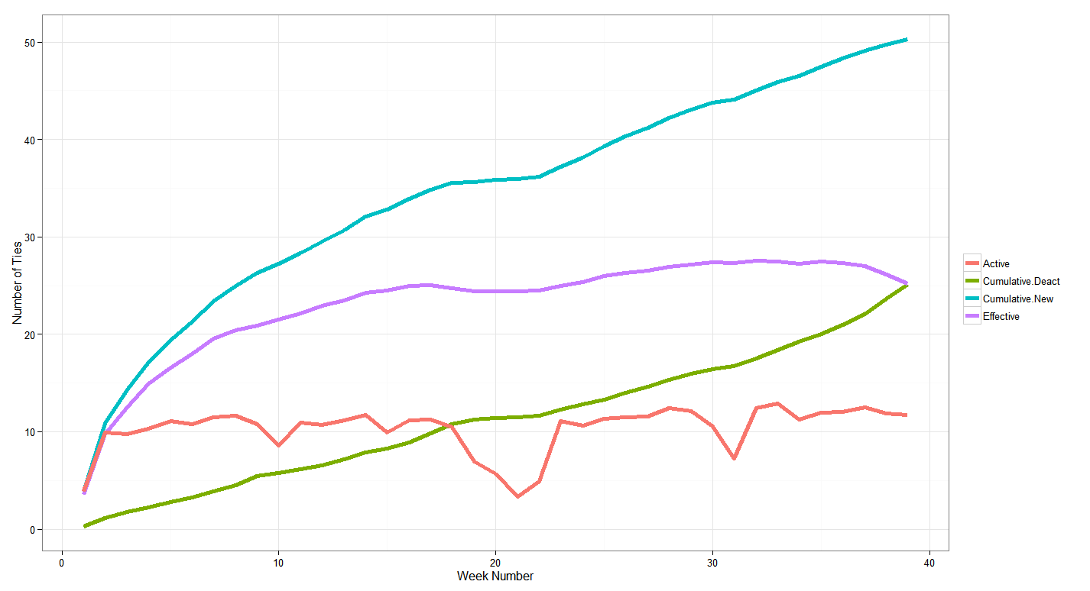
Mean weekly values of Cumulative Degree, Cumulative Deactivated Ties, Effective Degree and Active Degree over 40 weeks (NetSense Data)
Growth Period (weeks 1-15)
Mean Effective Degree fairly stable, μ = 25-28
Mean Active Degree fluctuates because of period effects
Cumulative New
and Cumulative Deactivated captures churn

